Slide 1
(SeismicQuake) Seismic Detection,Visualisation and Analysis
IDIC CONFERENCE
PREPARED BY:
PROF . JOSMY GEORGE
JUSTINE BIJU PAUL
NISSA ANN SAJI
BIJIN BINOY
ALLAN SHIBU KOSHY

Slide 2
CONTENTS
INTRODUCTION
EXISTING SYSTEMS AND LIMITATIONS
PROPOSED SYSTEM AND ADVANTAGES
PROPOSED METHODOLOGY
ARCHITECTURE
INITIAL MODULES
RESULT AND DISCUSSION
FUTURE PLANS
CONCLUSION

Slide 3
Introduction
Earthquake detection and warning systems are designed to identify early seismic signals, assess risk, and quickly alert people and infrastructure in danger.
These systems use real-time data from sensor networks, signal processing, and sometimes machine learning for rapid earthquake recognition.
The goal is to provide advance warning—seconds to minutes before shaking—to enable protective actions that reduce injury and damage.

Slide 4
Existing System
STA/LTA Trigger: Detects events by comparing short- and long-term seismic energy ratios.
Manual Phase Picking: Experts manually identify P- and S-wave arrivals for epicenter location.
Template Matching: Matches incoming signals with known earthquake waveform templates.

Slide 5
Limitations of Existing Systems
High False Alarms: Noise sensitivity causes frequent false detections requiring manual filtering.
Scalability and Latency Issues: Large data volumes and manual verification lead to delays and poor real-time performance.
Parameter Sensitivity: Algorithms need careful, station-specific parameter tuning.

Slide 6
Proposed System
SeismicQuake is an end-to-end deep learning framework replacing heuristic triggers with learned representations.
The system is autonomous (fully automated detection, classification, and characterization), noise-resilient (trained on large datasets to separate noise from seismic signals), and real-time (optimized for low-latency inference).
It integrates three specialized neural networks into a cohesive pipeline with a user-friendly desktop interface.

Slide 7
Advantages Of Proposed System
Superior accuracy: 96.81% in binary detection and 99.69% in wave classification, far exceeding traditional triggers.
Granular analysis: Distinguishes P, S, and surface wave phases for automated phase picking and epicenter triangulation.
Fast magnitude estimation: Delivers magnitude with MAE 0.37 within seconds of P-wave arrival.
Robust and Generalizable: Trained on the diverse STEAD dataset to handle varied noise and geological settings.
Cost-effective: Runs on standard consumer GPUs without specialized seismological hardware.

Slide 8
Proposed Methodology
Data Acquisition
The system utilizes the STEAD (Stanford Earthquake Dataset), a global dataset of over 1.2 million labeled seismic traces.
Inputs: 3-component seismograms (East, North, Vertical).
Labels: Earthquake/Noise tags, P/S arrival times, and source magnitudes

Slide 9
Data Preprocessing
• Channel Selection: The Vertical (Z) component is extracted as it typically contains the clearest P-wave arrivals.
• Normalization: Waveforms are normalized to the range [-1, 1] to ensure
numerical stability during training.
• Windowing: Signals are sliced into fixed-length windows of 400 samples
(4 seconds at 100Hz) to capture local temporal features.
• Balancing: Class weights are computed to handle class imbalance during
training.

Slide 10
Model Development
Three distinct models were developed to handle specific tasks:
1. Earthquake Detector: A binary classifier to filter noise.
2. Wave Classifier: A multiclass classifier to identify wave phases.
3. Magnitude Predictor: A regression model to estimate earthquake size.

Slide 11
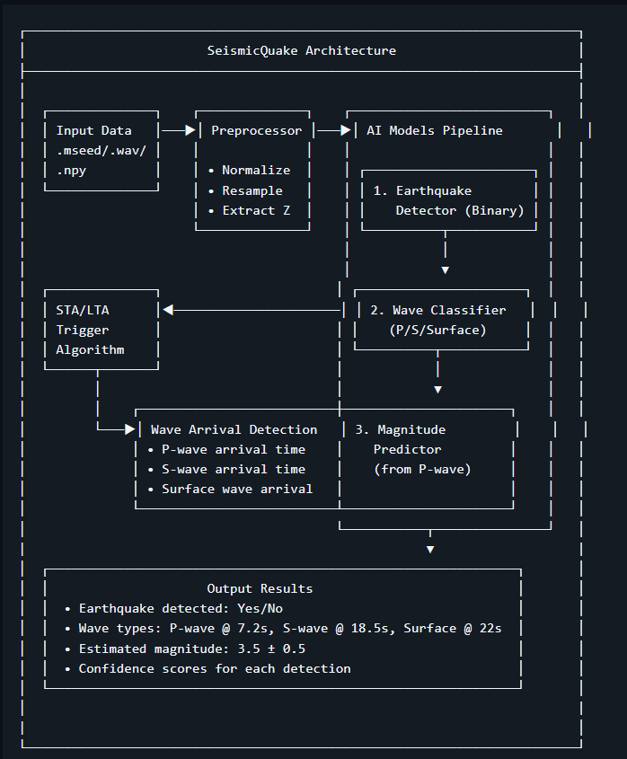
Architecture

Slide 12
Initial Modules
Data Sets
The data set needed was obtained from STEAD[Stanford Earthquake Dataset].
Has about 1,000,000 data sets containing P,S and Surface waves which was cleaned,processed and filtered.
So the data set was reduced to 500,000 data sets.
Stored as numpy binary and opened via HADOOP.
Can be accessed via Kaggle.

Slide 13
Input Module
• Supported Formats: MiniSEED (.mseed), WAV audio (.wav), and
NumPy arrays (.npy).
• Stream Handling: Implements a ring buffer to handle continuous real
time data streams.
AI Core Module
• Earthquake Detector: 4-layer 1D CNN with Global Average Pooling.
• Wave Classifier: 4-layer 1D CNN with an Attention Mechanism to
focus on distinct wave characteristics.
• Magnitude Predictor: Hybrid CNN-LSTM architecture. CNN layers
extract spatial features, while the Bidirectional LSTM captures temporal
dependencies critical for magnitude estimation

Slide 14
Models
Trained models with contained 1000 data sets of each with contains following data sets :
1. Primary waves
2. Secondary waves
3. Surface waves
4. Noise
Trained for initial phase of recognizing each waves but only have 30% accuracy.

Slide 15
Visualization Module
• Waveform Plotting: Renders seismic traces with color-coded detection overlays.
• Confidence Timeline: Displays model confidence scores over time.
• Real-time Dashboard: Live updating view for monitoring active
streams.

Slide 16
Result and Discussion
Earthquake Detection ()
• Accuracy: 96.81%
• AUC-RUC: 99.59%
• Discussion: The high AUC score indicates the model is extremely effective at ranking earthquake signals higher than noise, even at low false positive rates.

Slide 17
Wave Classification (Multi-class)
• Overall Accuracy: 99.69%
• Per-Class Accuracy:
–> P-wave: ~99%
–> S-wave: ~99%
–> Surface wave: ~99%
• Discussion: The attention mechanism proved crucial here, allowing the model to distinguish the subtle onset of P-waves from the higher-amplitude S-waves

Slide 18
Magnitude Prediction (Hybrid Deep Learning)
• Mean Absolute Error (MAE): 0.37
• Within ±0.5 Magnitude: 75.0%
• Within ±1.0 Magnitude: 93.1%
• Discussion: Estimating magnitude from just 4 seconds of P-wave data
is challenging. An MAE of 0.37 is a strong result, providing a reliable
‘ballpark’ estimate for early warning purposes before the full seismic event has concluded.

Slide 19
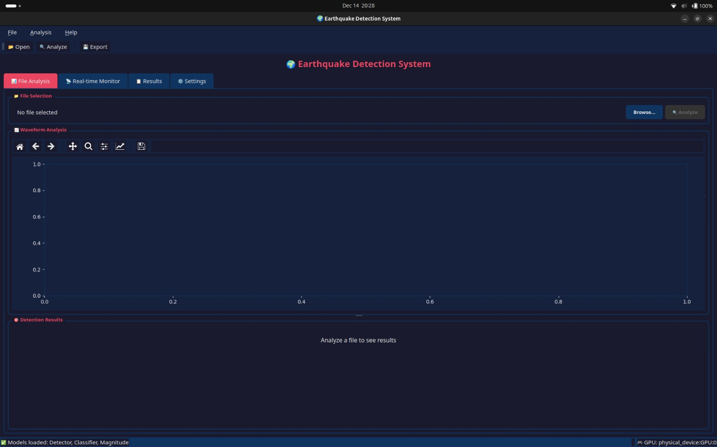
UI/UX Interface
Created a clean,easy to understand and also to work with also.
The interface also easy visulaization of seismic waves.
Fig 1: Intial UI/UX interface without any data/analysis

Slide 20
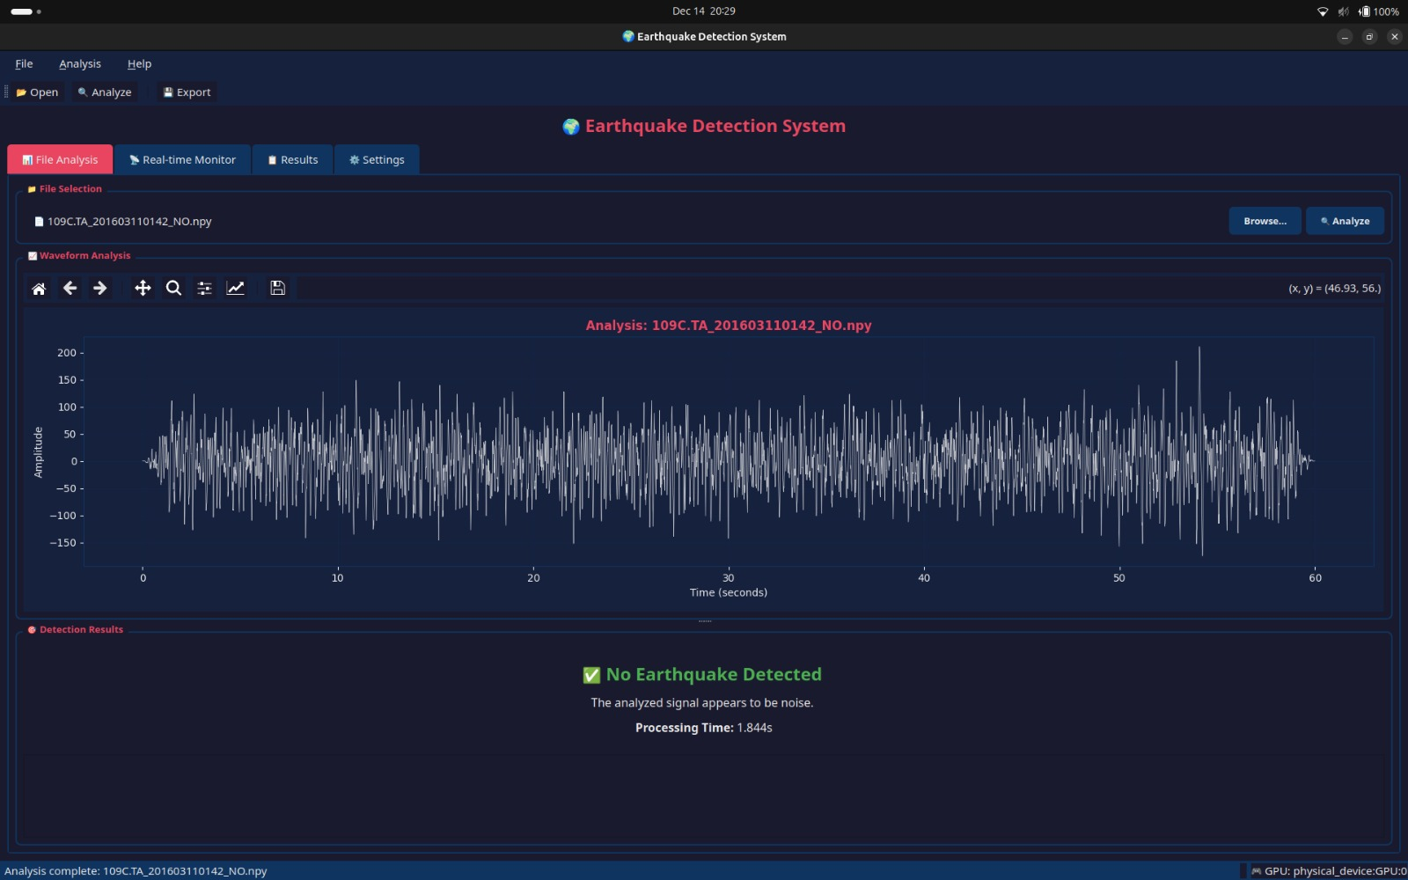
Fig 2: Interface after analysing file with no earthquake

Slide 21
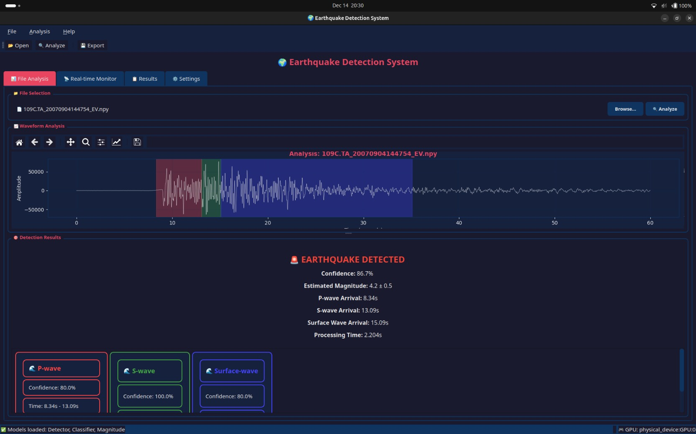
Fig 3: Interface after analysing file with with earthquake

Slide 22
Future Plans
Distributed sensing: Use consensus across geographically dispersed sensors for more precise event localization.
Edge AI: Deploy TensorFlow Lite models on low-power devices (Raspberry Pi, ESP32) directly connected to seismometers.
Transformers: Explore Transformer-based models (e.g., Earthquake Transformer) for better long-range dependencies and magnitude prediction.
Unsupervised learning: Add anomaly detection to capture rare or unknown seismic events outside standard patterns.

Slide 23
Conclusion
Improved Performance:Deep learning enhances detection, wave classification, and magnitude estimation.
Real-Time Reliability:High accuracy, low latency, and noise resilience enable faster early warnings.
Scalable Solution: Cost-effective, scalable, and extensible for modern seismic systems.

Slide 24
THANK YOU

